Slide 1


A State Level
AAZADI KA AMRIT MAHOTSAV HACKATHON-2022
Organized by Education Department (Higher and Technical) Government of Gujarat
A Report On:
FILE TRACKING SYSTEM
College Name:
Sal Engineering and Technical Institute-Ahmedabad

Slide 2



File Tracking System
PROBLEM ID: PID436

Slide 3
Submitted by:
Gaurav Jethva(201260116506)
Shivkumar Patel (201260116513)
Javlan Patel (201260116512)
Heet Patel (201260116515)
Khyati Patel (201260116511)
Urvi Patel (201260116514)

Slide 4

Abstract
For solution we use certain web technology to provide user friendly web application. In which the status of file document, location (tracing ) and some other things show to the user’s dashboard.
Authentication of user (Client) is done by the Aadhaar Card number. This Web application contain user friendly environment similar to current mail system.
User documents are manipulated like forwarding, rejection/approval of document/files in electronic format (Electronic Format means text-based or image-based content in a form that is produced on). To provide security for user documents are done by using certain algorithms like hashing and so on. It is manipulate under Centralized server with sufficient backbone connectivity, storage space.

Slide 5
Domain Description
File tracking system project is implemented in php platform using MySQL as back-end database. Main idea of this project is to develop a software application which can handle file sharing in a organization for providing best service for users and completing work in less time. This application is implemented in three modules, admin module, department module, client module. In existing system in every government office manual work is preferred which is a time taking process and cannot provide best service for users in less time and in manual work there is no preference time of completion of work which is irritating for people. In order to solve this problem we implement a web application through which application process is done through online and status of application can be known from time to time.

Slide 6
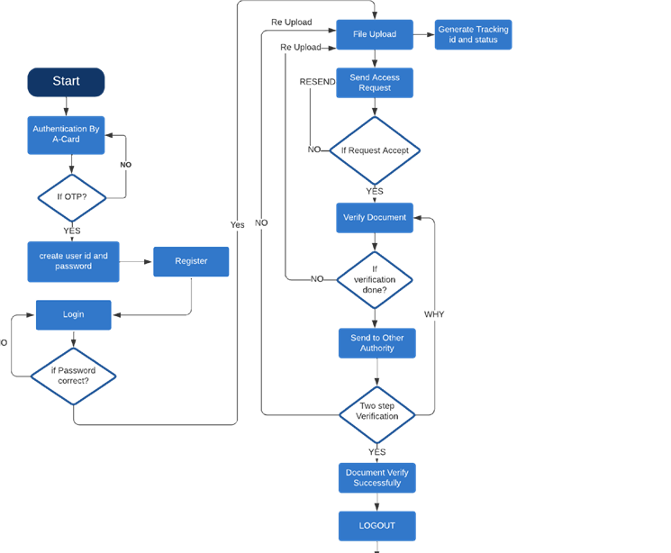
Flow Chart:

Slide 7
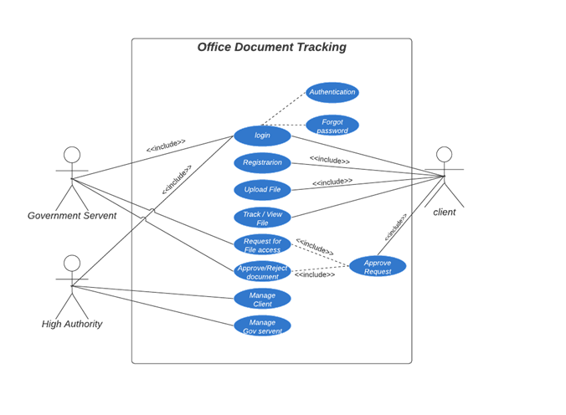
Use Case:

Slide 8
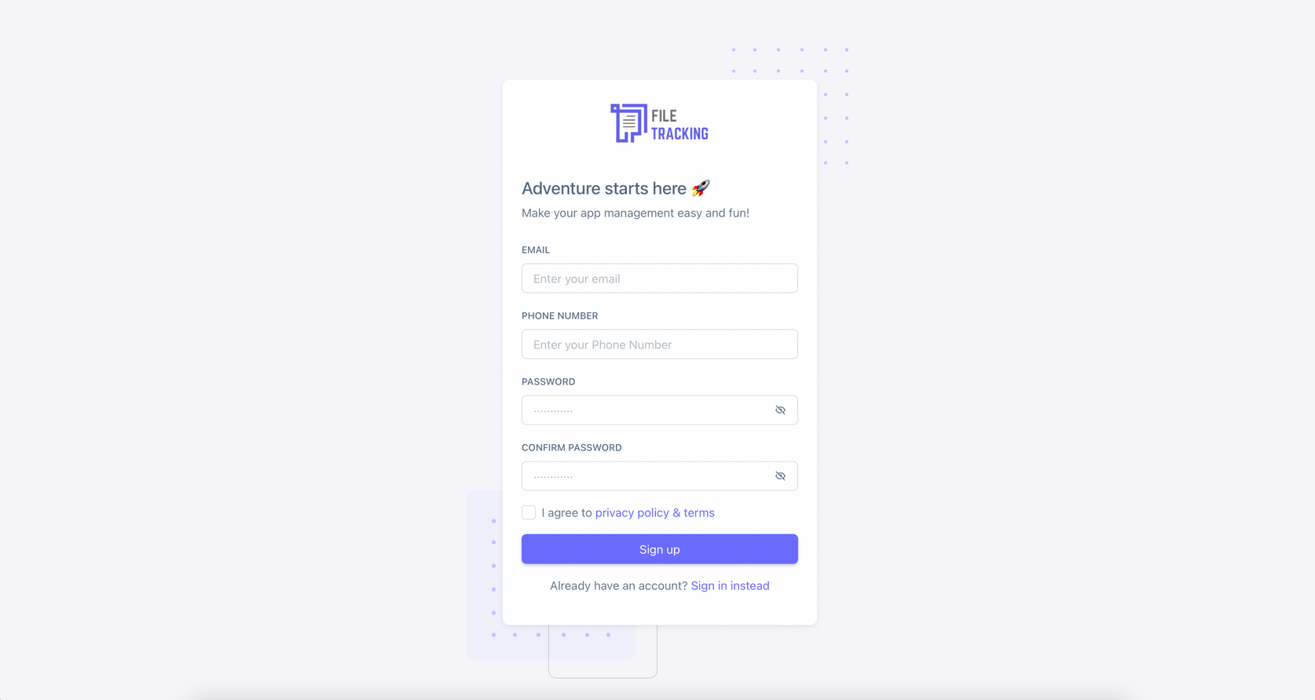
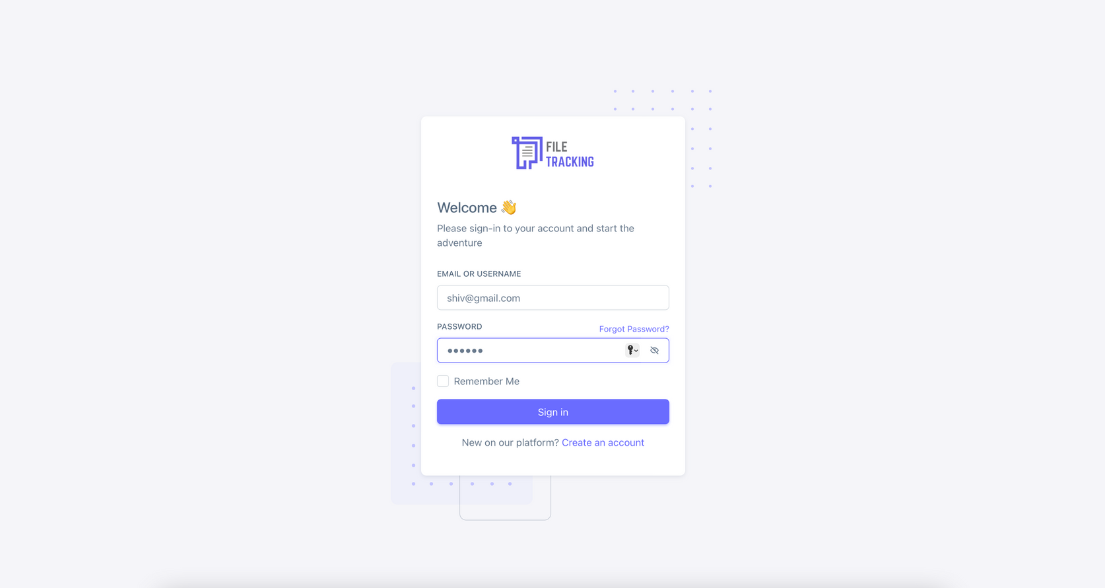
Prototype:

Slide 9
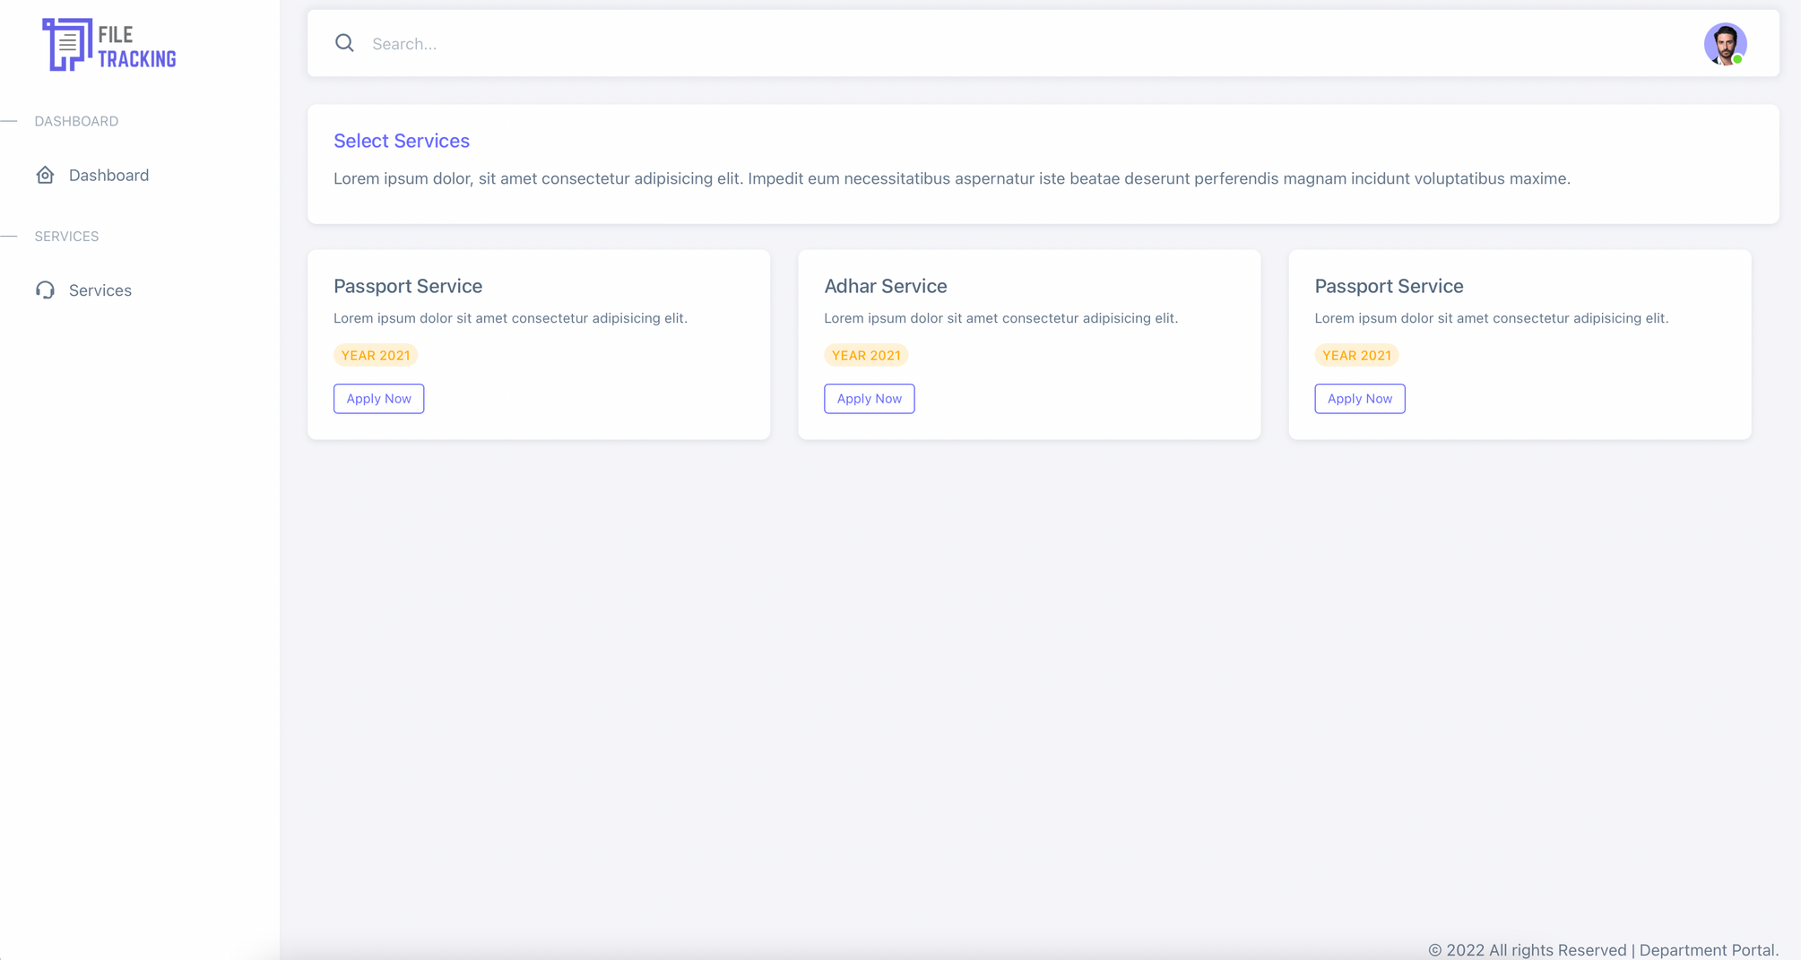

Slide 10
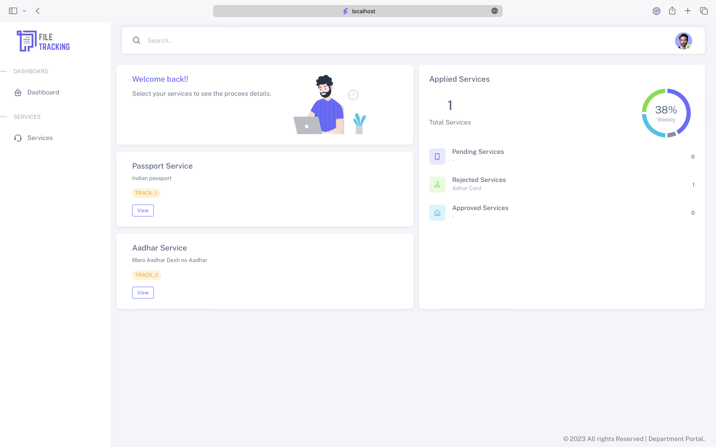
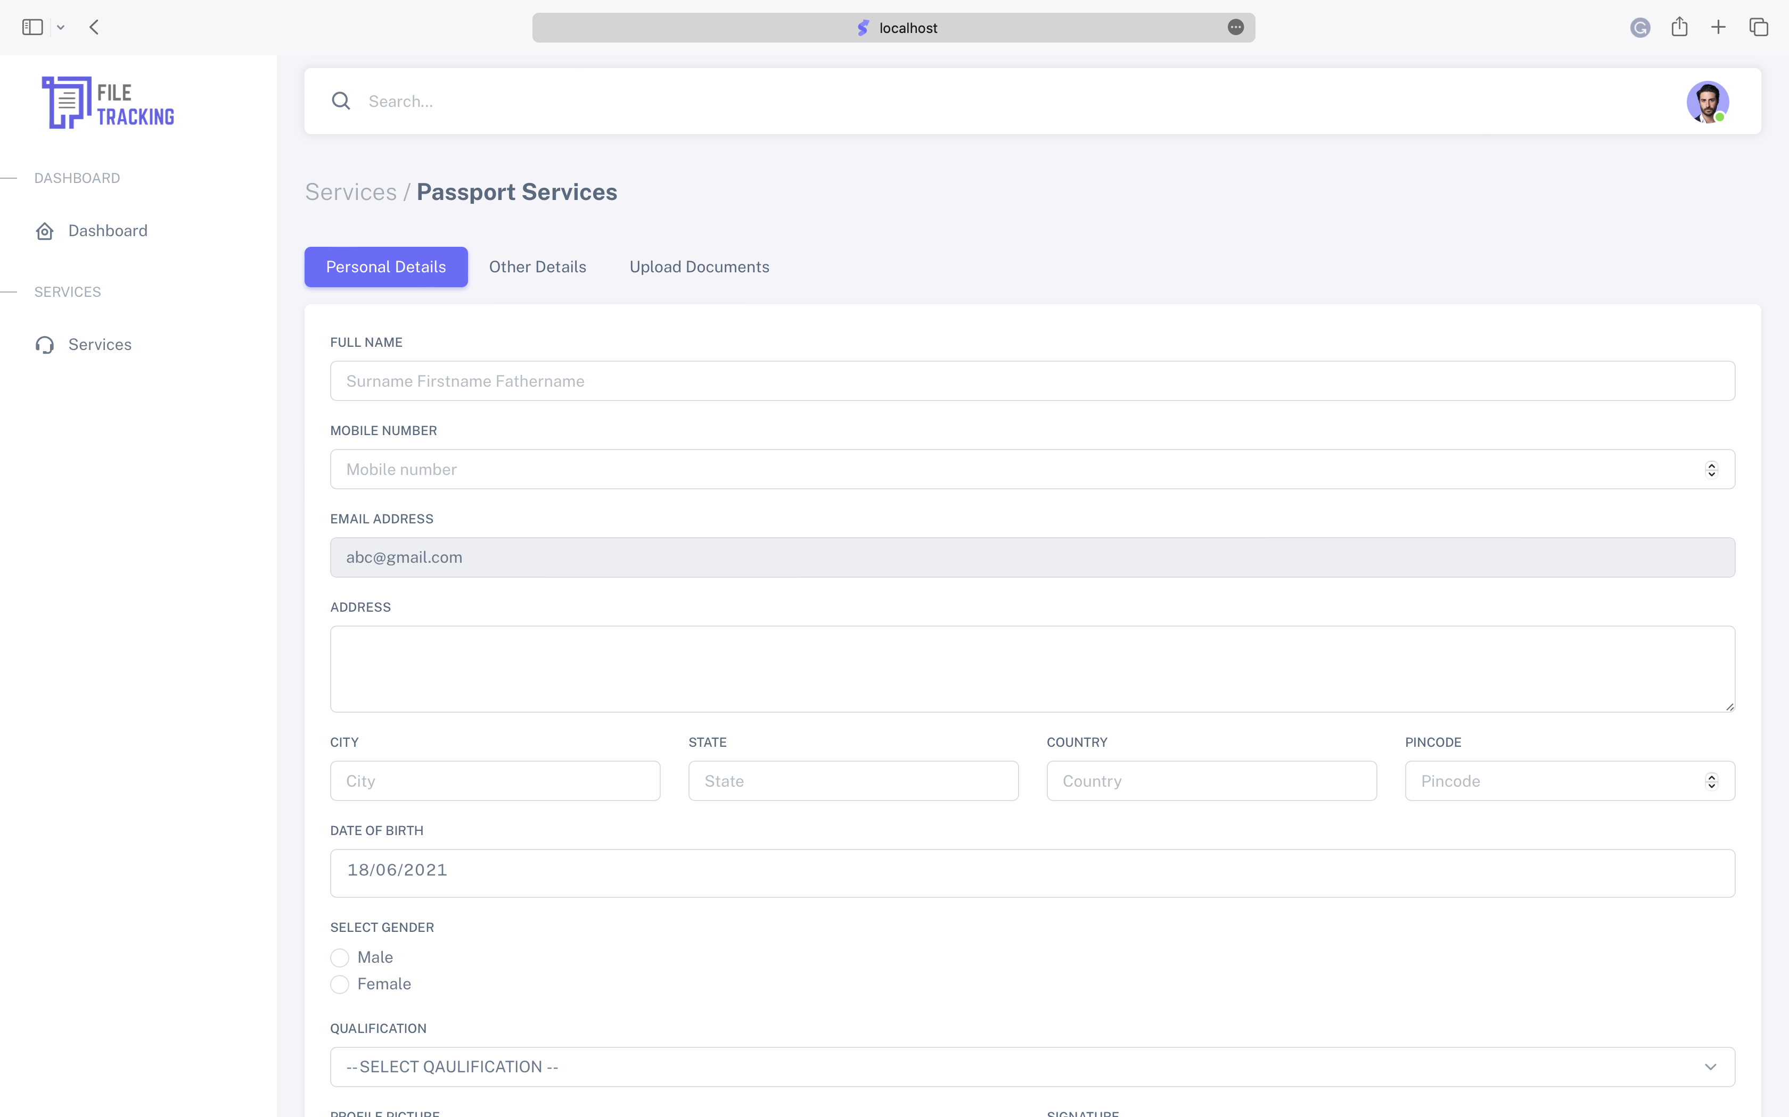

Slide 11
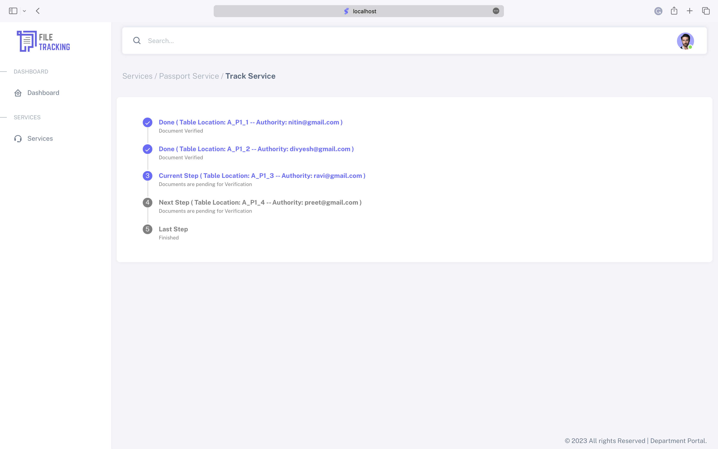
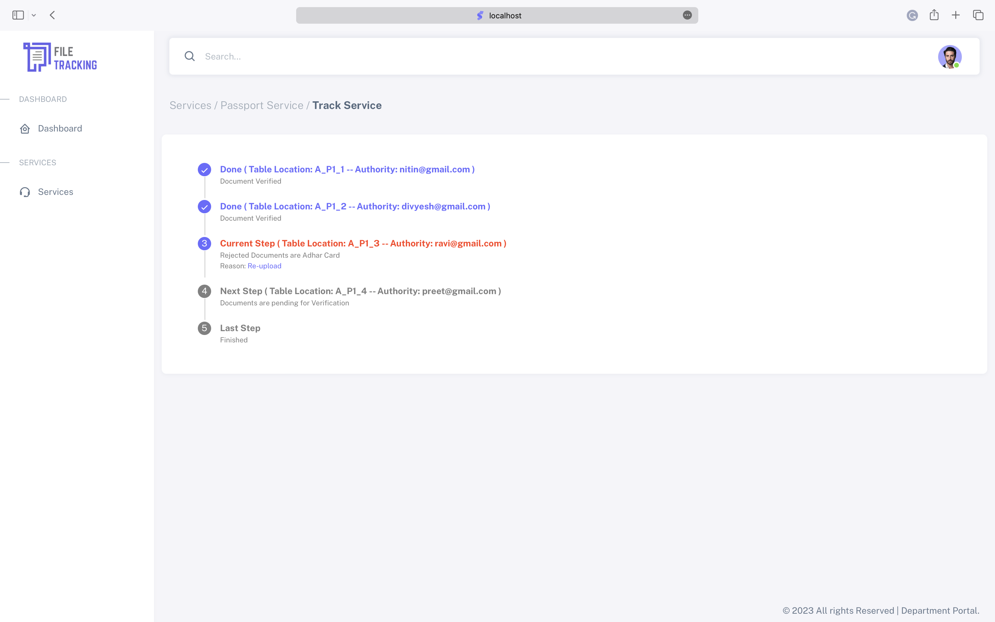

Slide 12
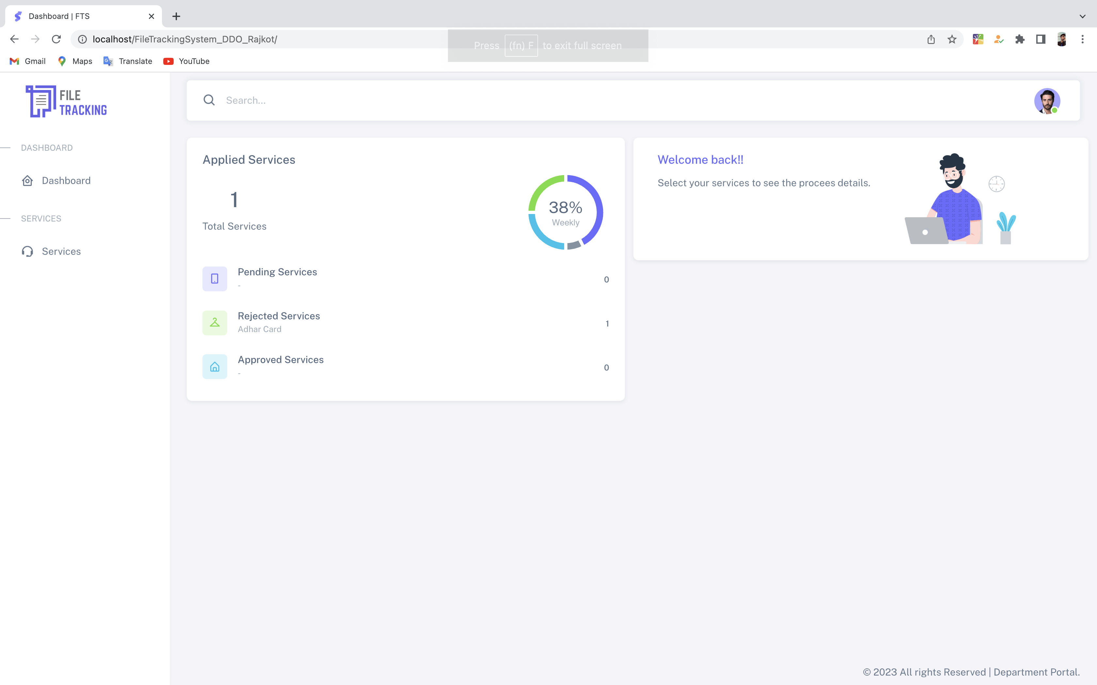
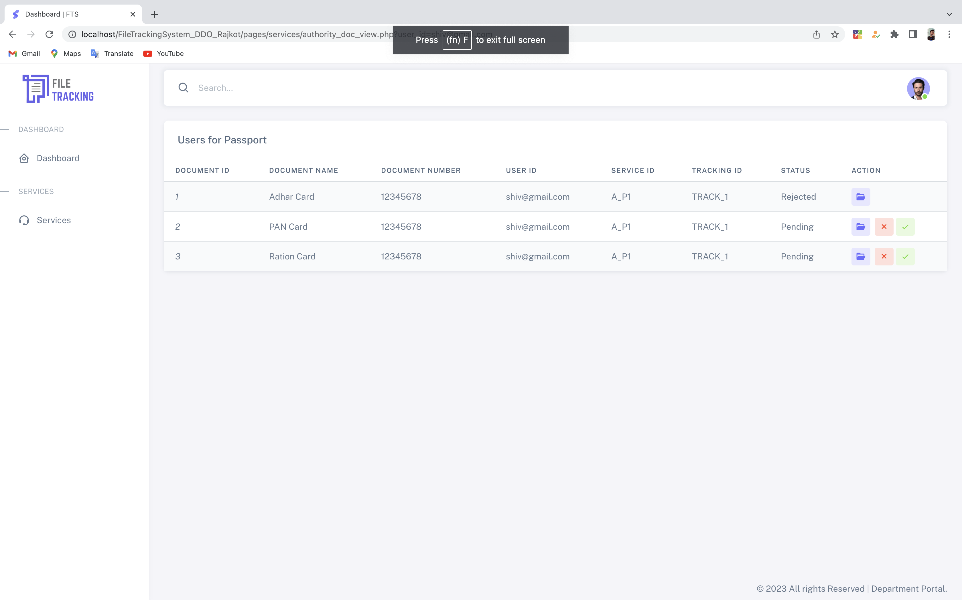

Slide 13
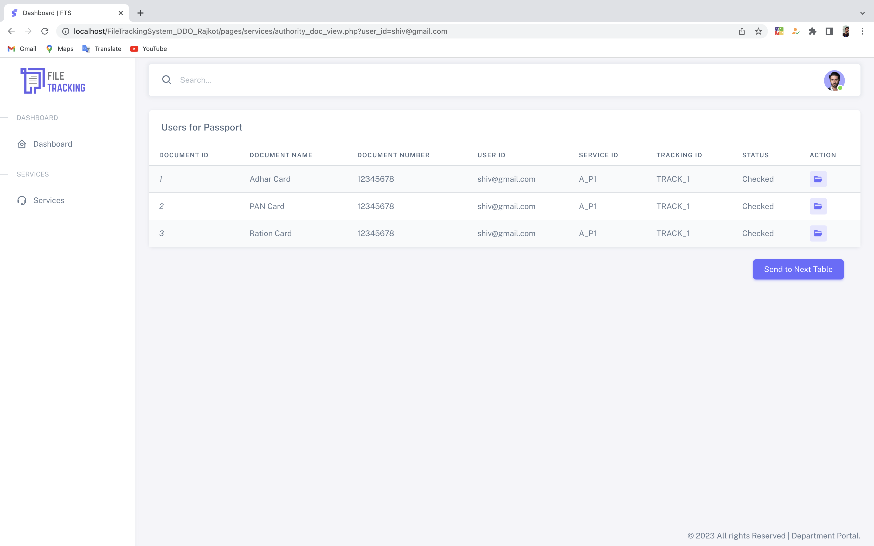

Slide 14
Describe your Technology stack here :
PHP (For Backend )
MySQL ( For Database connectivity)
Java Script ( For Form Validation )
Bootstrap , CSS 3 , HTML 5 ( For front end)

Slide 15
Describe Your Dependencies:
Internet connectivity
database server
Server for Hosting File
External API
allgorithm (tracking , hashing)

Slide 16
Thank You!

